Slide 1

RCB Player & Team Performance Analysis
This analysis leverages historical IPL data to examine Royal Challengers Bangalore's performance. The goal is to identify top-performing players and improve team composition for future IPL seasons. We'll delve into individual player stats and overall team performance across various seasons, providing data-driven insights for strategic player selection.
BY Saubhagya Monal

Slide 2
Objective: Championship Title Through Data
Royal Challengers Bangalore (RCB) has been a consistently competitive team in the IPL but has struggled to secure a championship title. The management aims to leverage data to identify top-performing players and improve team composition ahead of the mega player auction for IPL 2017.
1
Data-Driven Insights
2
Improve Team Composition
3
Strategic Player Selection
Focus on performance trends and data to drive selection strategies.
Identify top-performing players to optimize team balance.
Develop effective strategies for player selection based on historical data.

Slide 3
Database Schema and Key Data Points
The data is sourced from the IPL database, including detailed information across multiple tables like Ball_by_Ball, Matches, Player, Wicket_Taken, and Venue. The relationships between tables help track player performance in matches, seasons, and venues. SQL queries were crafted to extract insights from the database.
Ball_by_Ball
Matches
Player
Tracks individual ball deliveries during matches.
Provides information on match outcomes, winners, toss decisions, and venue.
Contains player-specific data, including runs scored, wickets taken, and roles.

Slide 4
Methodology Overview
SQL
Visualization
SQL queries were crafted to extract insights from the database. These queries focused on important metrics such as total runs, player performance by season, consistency, venue-based analysis, and the impact of toss decisions on match outcomes.
Created visualizations like bar charts, column charts, and tables in Excel to better illustrate performance trends and KPIs.

Slide 5
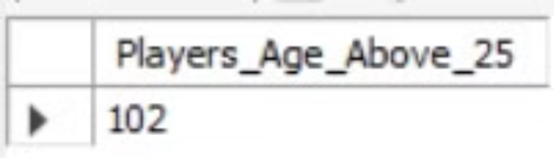
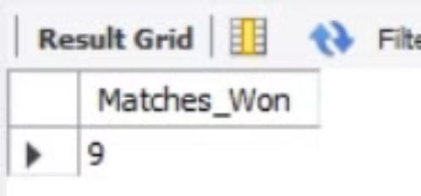
Key Metrics & Findings
Identified the players who were older than 25 years in 2014.
Calculated the number of wins for RCB in the 2013 season.
Total Players Over 25: 8 Players
Matches Won in 2013: 9 Matches
Notable Players: Virat Kohli, AB de Villiers

Slide 6
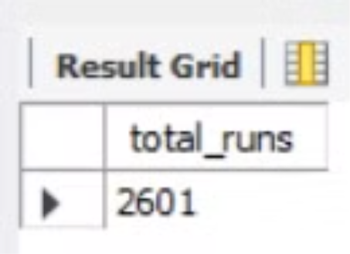
Total Runs Scored by RCB in 1st Season
In their inaugural IPL season, RCB showcased promising batting prowess, accumulating a total of 2601 runs, inclusive of extra runs. This indicates a strong start in their IPL journey, underlining the team's potential in the league.
2601
Total Runs
Runs scored by RCB in their first IPL season, including extra runs (wides, no-balls).

Slide 7
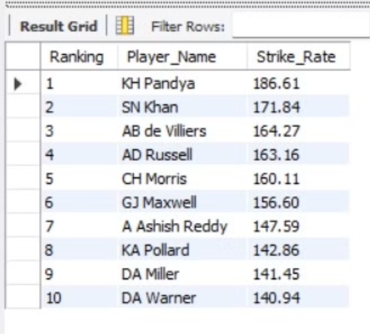
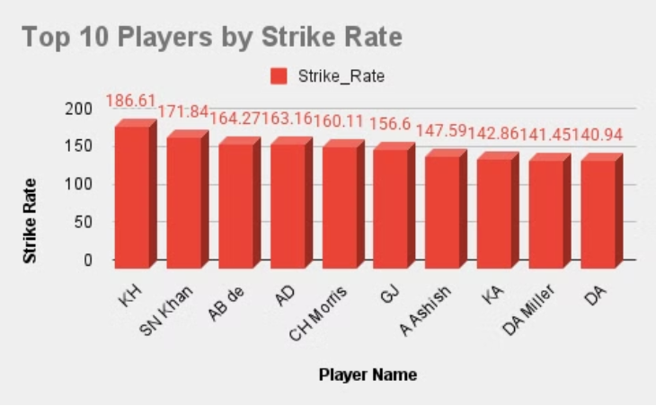
Top 10 Players by Strike Rate (Last 4 Seasons)
Identifying players with high strike rates helps in recognizing the most aggressive batsmen. KH Pandya tops the list with a strike rate of 186.61, followed by AB de Villiers at 164.27, and DA Miller at 141.45. These players are crucial for accelerating the scoring rate.
KH Pandya
AB de Villiers
DA Miller
Strike Rate: 186.61
Strike Rate: 164.27
Strike Rate: 141.45

Slide 8
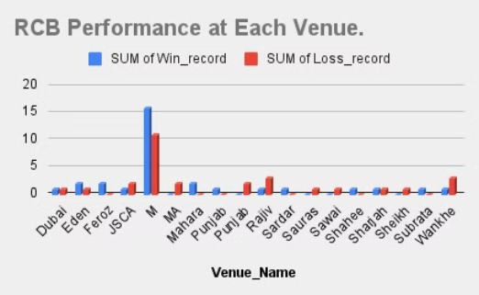
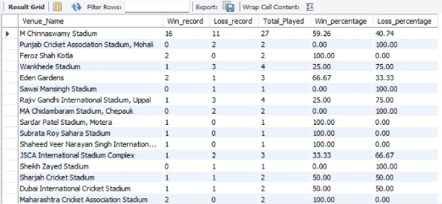
RCB's Venue-Based Performance Analysis
Sardar Patel Stadium,Motera 100% wins
RCB’s win percentage varies across different venues. At M. Chinnaswamy Stadium, they have a 59.26% win rate, followed by Eden Gardens at 66.67%, and Sardar Patel Stadium at 100%. This venue analysis helps in understanding where RCB performs best and can influence strategic match planning.
M. Chinnaswamy Stadium
Eden Gardens
59.26% Wins
66.67% Wins

Slide 9
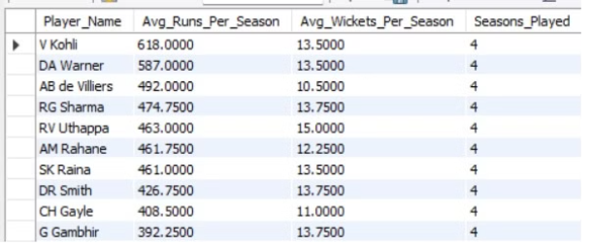
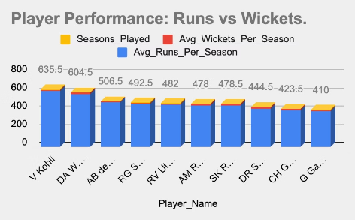
Consistently Performing Players
Consistency is key in team performance. Virat Kohli has had 4 seasons with over 618 runs, AB de Villiers 4 seasons with over 492 runs, and RV Uthappa 4 seasons with over 15 wickets. These players provide stability and reliability to the team.
1
Virat Kohli
4 seasons with over 618 average runs per season.
2
AB de Villiers
4 seasons with over 492 average runs per season.
3
RV Uthappa
4 seasons with over 15 average wickets per season.

Slide 10



Strategic Player Selection Recommendations
To improve team composition and performance, focus on all-rounders, player consistency, and strategic toss decisions. Prioritize players who have delivered consistent performance year after year, ensuring stability in team selection. Improve toss decision-making strategies to maximize advantages.
All-Rounders
Prioritize all-rounders who can contribute in both batting and bowling to enhance flexibility and balance in the team.
Consistency
Continue to build around consistent performers like Virat Kohli, AB de Villiers, and Yuzvendra Chahal for stability.
Toss Strategy
Improve toss decision-making strategies, as winning the toss generally improves the chances of success, particularly when choosing to bat first.

Slide 11
Conclusion
RCB has shown competitive performance over the years but has struggled to secure an IPL championship, with inconsistencies in team performance across different seasons, especially during critical phases like the Powerplay and Death overs.
Key players like Virat Kohli and AB de Villiers have been the backbone of the team, consistently delivering high performances, with Virat Kohli averaging over 618 runs per season and AB de Villiers maintaining over 492 runs per season over multiple IPL seasons.
RCB's performance in Powerplay (1-6 overs) has been highly variable, with a notable high of 886 runs in one season and a low of 132 runs in another, indicating the need for improvement in the early overs, especially in terms of run acceleration and wicket management.
Venue-based performance shows that RCB performs best at Sardar Patel Stadium with a 100% win rate, while their win rate at M. Chinnaswamy Stadium is 59.26% and Eden Gardens has a 66.67% win rate, suggesting that RCB should tailor strategies based on the venue.
To improve team composition, RCB should focus on all-rounders who provide flexibility, prioritize players with consistent performance like Kohli, De Villiers, and Chahal, and improve their toss decision-making strategies, as winning the toss has shown to increase their chances of success, particularly when choosing to bat first.

Slide 12
References
SQL Queries: Extracted insights from IPL dataset.
Tools Used: SQL for analysis, Excel for visualizations.

